Slide 1
Charming with Docker
Charles Butler
Oct 2015

Slide 2
Q: What does `juju deploy docker` really do?
A: Installs docker on a host… yep. That’s pretty much it.

Slide 3
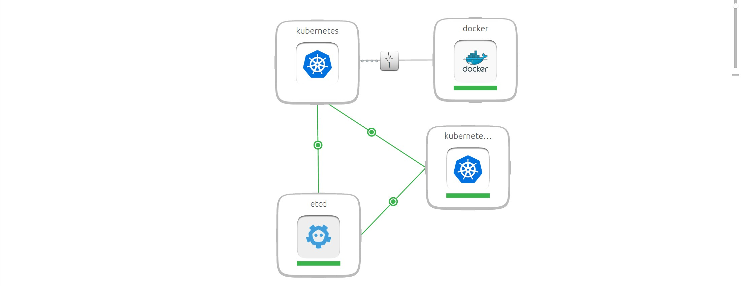

Slide 4
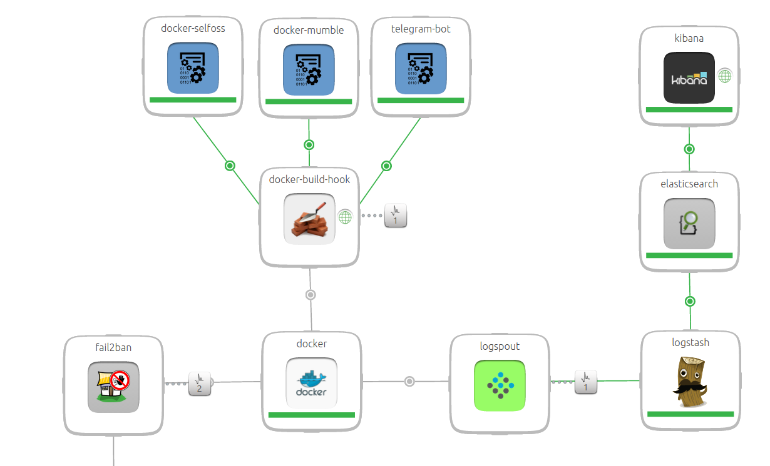

Slide 5
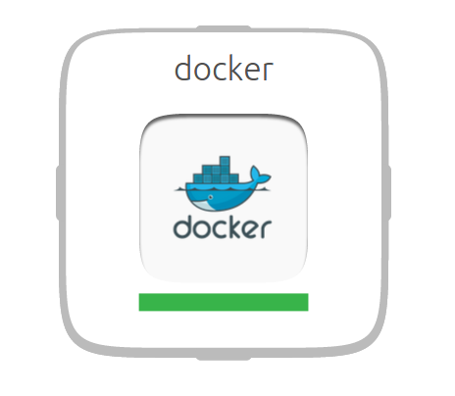

Slide 6


Slide 7
Reactive Pattern Emerges

Slide 8
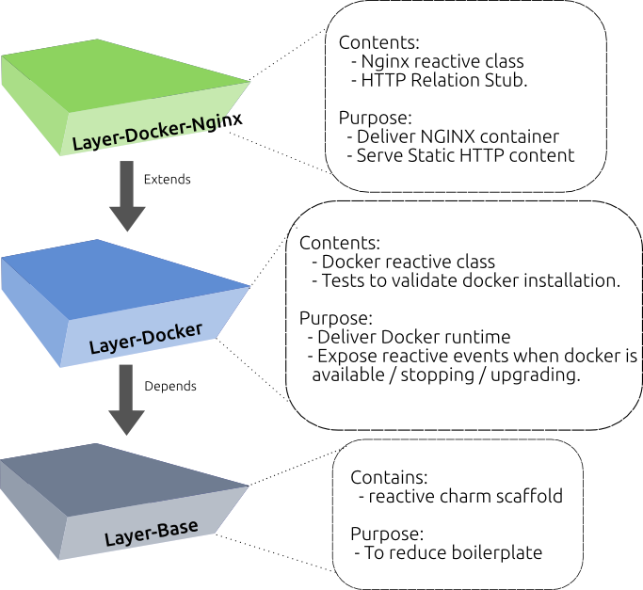

Slide 9
Prepare to be excited
layers.yaml
includes: [‘layer:docker’, ‘interface:http’]

Slide 10
Prepare to be excited (cont.)
reactive/high-scores.py
@when(‘docker.available’)
@when_not(‘ghs.running’)
def run_app():
cmd = ‘docker run -d -p 80:8000 lazypower/github-high-scores’
check_call(split(cmd))
reactive.set_state(‘ghs.running’)

Slide 11
Onboarding ISV engineers
Charm Design Sessions are now focused on:
events to raise
when
and how to subscribe to them
common/shared interface layers
and base layers.

